Slide 1

Donations
and Donors

Slide 2
Trend of donations over years

Slide 3

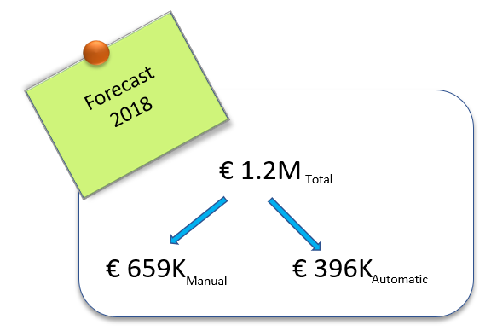


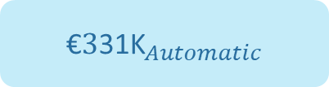
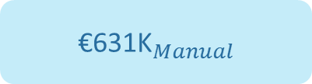
Number of donors
Average Frequency
Average Donation Value
8100
1.6
51
€${\text{631}\text{K}}_{Manual}$
$${Total Donation}_{2017}$$
2490
10.1
14
€${\text{3}\text{31}\text{K}}_{Automatic}$
Focus on :
Number of Donors
Average Frequency
Average Donation Value

Slide 4




Slide 5

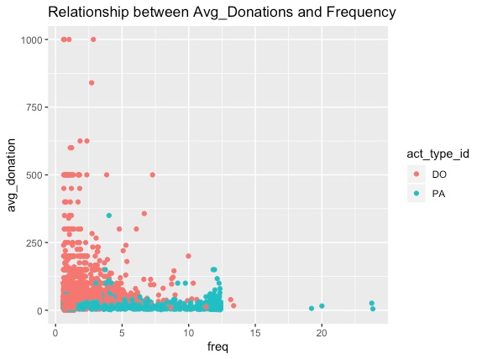

Take away for focused campaigning
From this chart, its evident that donors are well segregated as per,
1. Count of donors in DO and PA
2. Frequency of donations
3. Average value of donations
So, campaigns needs to be drafted accordingly.

Slide 6
Observed seasonality in manual and automatic donations

Slide 7
Influence of Campaigning channels from past 4 years

Slide 8
Observations based on Prefixes
Total amount of donation received from women is higher
The proportion of donation amount per prefix seems stable over years.

Slide 9



Take away for focused campaigning
Holiday season in December sees highest inflow of manual donations. So focus on churned-out donors in this season with effective campaigns to reactivate them.
.
Campaigning through digital channel sees very high percentage of increase in donations as compared to mailing channel. Focus more on Digital Campaigns.
It is evident from our observation that the major part of donations are received from women. Focus our campaigns towards increasing the number of male donors too.

Slide 10
Observations on Demographics of Donors
The presence of Biding, in the top-6 is due to the presence of one single generous donator in this small city.

Slide 11
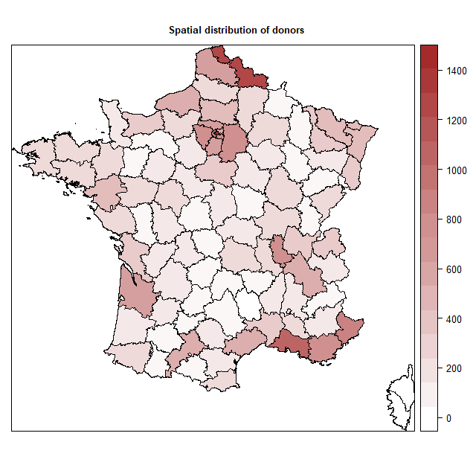
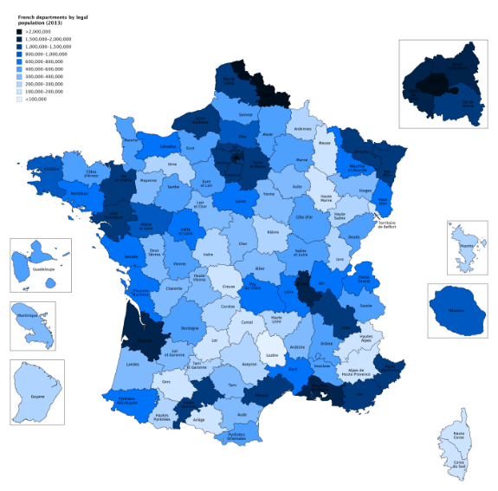
Observation on Spatial distribution of donors
The three clustered donors highlighted in the spatial distribution have remained stable from past 20 years.
These donor clusters are highly related to demographic clusters, of course, but it is interesting to find that some locations with larger population, like those in the northwest and in the northeast, do not have corresponding higher donor amount. Therefore, these locations may be the focus of future campaigns.
Take away for focused campaigning

Slide 12
Donor Segments
Segmentation variables : Recency, Automatic deduction, First donation, and Generosity
36+ MONTHS
25-36 MONTHS
13-24 MONTHS
0-12 MONTHS
LOST
COLD
WARM
AUTO
TOP
(≥ 100 EUR)
BOTTOM
(< 100 EUR)
NEW
12

Slide 13
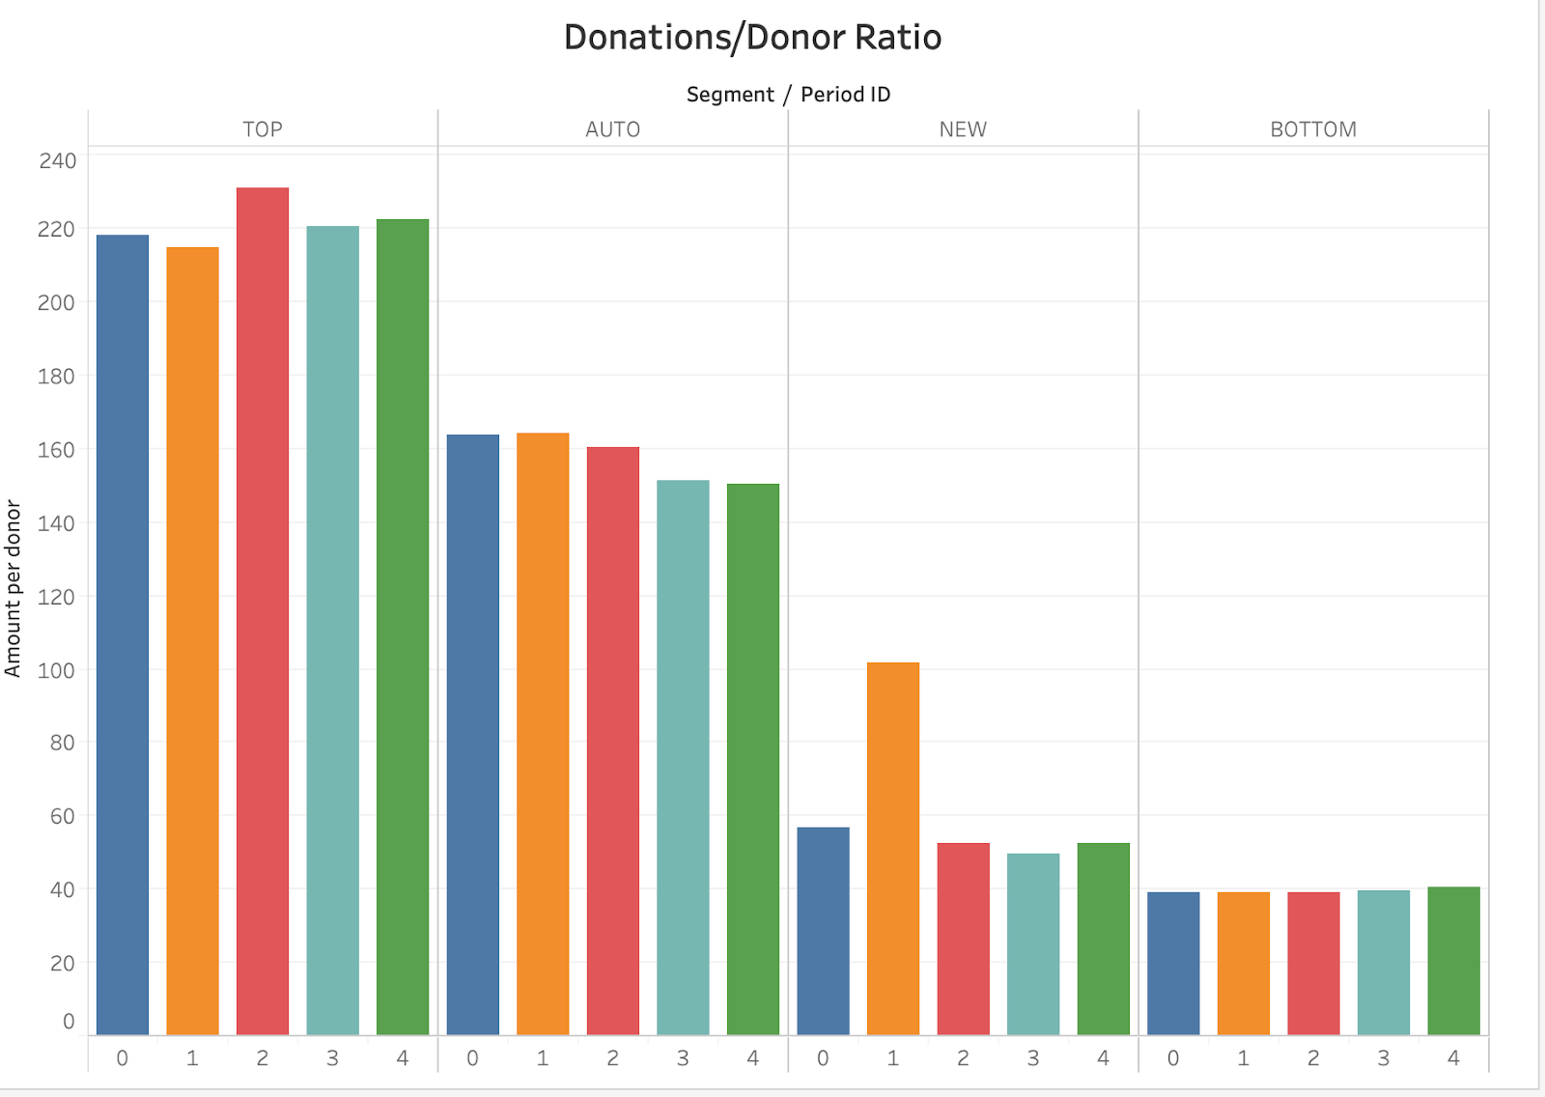

Segmentation of Donors
* After excluding one donor (outlier), donations/donor of New segment in period 1 is 57, which is in line with other periods.
* Similarly, without the top 2 donations in TOP segment in period 2, donations/donor from Top segment is 207, which is in line with our expectations.

Slide 14
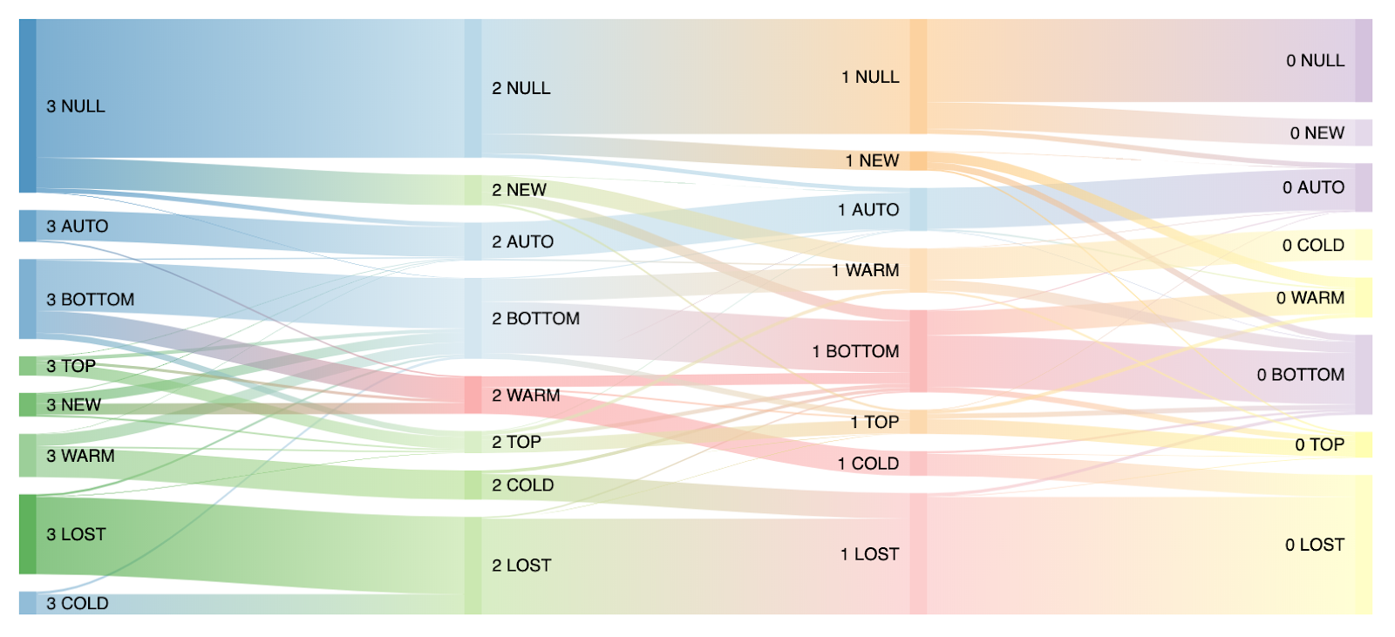
Movement of donors across segments

Slide 15


Movement of donors across segments
80 % donors from a Warm segment are Lost after two years (ex. flow from 3 Warm to 1 Lost)
25%-20% donors from a bottom segment are Lost after three years (ex. flow from 3 Bottom to 0 Lost)
This graph can help us to identify the donors we need to retain more and to win their loyalty.
If donors are Lost, we can almost assume that they are never going to come back to donate (ex. 3 Lost never donated later)

Slide 16
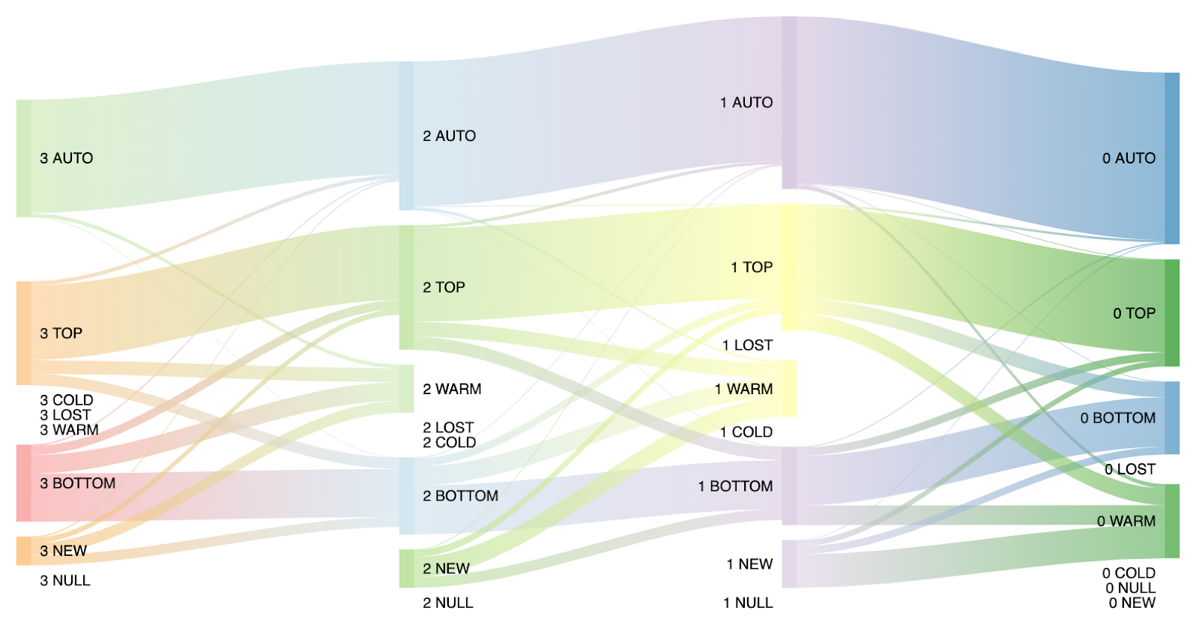
Generation of donations in donor segments

Slide 17
Generation of donations in donor segments
The dynamic of the last four years shows that the amount of money given by the « Auto » segment is growing, which seems to be a good thing fincancially speaking.
The amount of money given by the top segment remains stable over the four previous years.
Reading both the graphs together, we see 1.4K donors begin to donate in a 1 year window which contribute to 10% of the overall donations. However, 10K existing donors turn inactive without any donations. This reminds the importance of retaining donors.
This graph has to be put in perspective with the fact the global amount of donations is increasing over the years

Slide 18




Generation of donations in ‘New’ donor segment
First Donation
79% don’t donate in the same year after their first donation
17% of Donors
Avg. donation €130
Second Donation
3% of Donors
Avg. donation €65
Third Donation
Target campaigns on 79% of new donors that we get every year, who didn’t donate after their first donation in the same year.
1% of Donors
Avg. donation €50
Fourth Donation

Slide 19
Thank you
Priyanka Pippiri
Subhash Taneja Ankisetty
Thomas Dorveaux
Xiangyu Wang
Bhumana Prannoy Noel

